Slide 1
CS 0007: Introduction to Java
Lecture 12
Nathan Ong
University of Pittsburgh
October 20, 2016

Slide 2
Annoucements
Project 0 submission link is now available via CourseWeb
When submitting, please organize your source code and your essay into one zip file. The zip file name should be LastnameFirstname_Project0.zip
Please DO NOT include any *.class files

Slide 3
Type[] name = new Type[size];

Slide 4
int[] empty = new int[10];

Slide 5
int[] list = {1,2,3,4};

Slide 6
while(){…}
While a condition is true, run the block
While not at the end of the list, print out the next element
while(not at end of list)
{
System.out.println(next element);
}//end loop while(not at end of list)

Slide 7
while(){…}
int currElement = 0;
while(currElement < list.length)
{
System.out.println(list[currElement]);
currElement++;
}//end loop while(currElement<list.length)

Slide 8
So Many Things We Have to Remember…WHYYYYYYYYYY
int counter = start;
while(condition)
{
//Do stuff
counter increment
}//end loop while(condition)
There must be a better way
WILD KEYWORD APPEARS

Slide 9
for(;;){…}
The for loop allows us to put everything together for us!
for(counter = start; condition; counter increment)
Now we don't have to worry about the placement of the counter and incrementing it!

Slide 10
EQUIVALENCE
int counter = start;
while(condition)
{
//Do stuff
counter increment
}//end loop
//while(condition)
for(int counter = start; condition; counter increment)
{
//Do stuff
}//end loop for(condition)

Slide 11
for(;;){…}
for(int currElement = 0; currElement < list.length; currElement++)
{
System.out.println(list[currElement]);
}//end loop for(currElement < list.length)

Slide 12
A Note
Programmers are lazy
Therefore, currElement is too long for a name
Conventional counter names are:
i, j , k , l , m , n , c , a , b , d , num , count , counter

Slide 13
for(;;){…}
for(int i = 0; i < list.length; i++)
{
System.out.println(
list[currElement]);
}//end loop for(i < list.length)

Slide 14
int[] list = {1,2,3,4};
Let's Test It on List

Slide 15
Let's Test It on List
public class Test
{
public static void main(String[] args)
{
int[] list = {1,2,3,4};
for(int i = 0; i < list.length; i++)
{
System.out.println("Counting... Now at " + list[i]);
}//end loop for(i < list.length)
}//end method main
}//End class Test
What is the output?

Slide 16
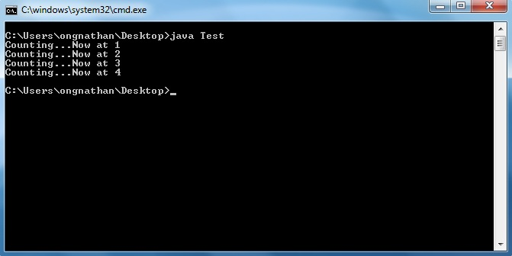
It works, YAAAAAYYYYYY!!!

Slide 17
Usage
When do I use For Loops?
  Iteration, or going through all of the elements of an array or other type of list.
  When the number of times you need to loop is known, either explicitly with a value, or through a variable.
While loops are used otherwise

Slide 18
Multi-dimension Arrays
Arrays don't just have to be lists
They can also be grids, cubes, hyper-cubes, …

Slide 19
Type[]…[] name = new Type[size1]…[sizeN];

Slide 20
Type[]…[] name = values…s;

Slide 21
int[][] listList = {{1,2,3},{4,5,6},{7,8,9}};

Slide 22
Things to Remember
In 2-D Arrays, referencing an element requires TWO PAIRS of square brackets
To get the #1 from listList
listList[0][0]
To get the #4 from listList
listList[1][0]
Remember: element → listList[row][col]

Slide 23
How Do We Go Through a 2-D Array?
If it took one for loop to go though a 1-D array, then…
It will take two for loops to go through a 2-D array
It will take N for loops to go through an N-D array
If you don't have to go through everything, don't. It just wastes time

Slide 24
We need to modify this
public class Test
{
public static void main(String[] args)
{
int[][] listList =
{{1,2,3},{4,5,6},{7,8,9}};
for(int i = 0; i < listList.length; i++)
{
System.out.println("Counting... Now at " + listList[i]);
}//end loop for(i < list.length)
}//end method main
}//end class Test
There is only one loop. How do we write the next one?

Slide 25
Inner For Loop
for(int i = 0; i < listList.length; i++)
{
//inner for loop
//…
//end inner for loop
}//end outer-loop for(i <
//listList.length)
What does the outer for loop go through?
What should the inner for loop go through?

Slide 26
listList[row][col]

Slide 27
Inner For Loop
for(int i = 0; i < listList.length; i++)
{
//inner for loop
//…
//end inner for loop
}//end outer-loop for(i <
//listList.length)
The outer loop goes through the row
The inner loop goes through the columns

Slide 28
Inner For Loop
//inner for loop
for(int i = 0; i < listList.length; i++)
{
System.out.println("Counting… Now at " + listList[i][i]);
}//end inner-loop for(i <
//listList.length)
Is this allowed?
No because i is already used

Slide 29
Inner For Loop
//inner for loop
for(int j = 0; j < listList.length; j++)
{
System.out.println("Counting… Now at " + listList[i][j]);
}//end inner-loop for(j <
//listList.length)
Is this allowed?
No because listList.length only gets the number of rows!
What can we do?
What if we use each individual row's length?

Slide 30
Inner For Loop
//inner for loop
for(int j = 0; j < listList[i].length; j++)
{
System.out.println("Counting… Now at " + listList[i][j]);
}//end inner-loop for(j <
//listList[i].length)
Does this work?

Slide 31
Let's Test It on listList
public class Test
{
public static void main(String[] args)
{
int[][] list = {{1,2,3},{4,5,6},{7,8,9}};
for(int i = 0; i < list.length; i++)
{
for(int j = 0; j < list[i].length; j++)
{
System.out.println("Counting...
Now at " + list[i][j]);
}//end inner-loop for(j < list[i].length)
}//end outer-loop for(i < list.length)
}//end method main
}//End class Test
For convenience sake, listList → list
What is the output?

Slide 32
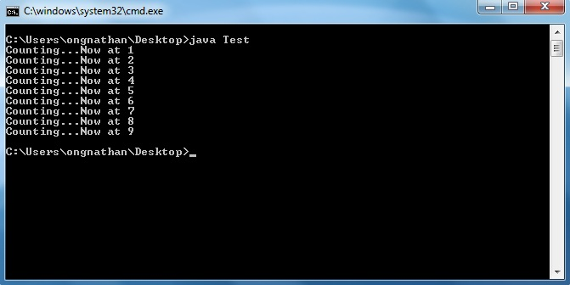
It works, YAAAAAYYYYYY!!!

